Slide 1
Computation / visualization interface
“Initial State – Deformation History” description (ISDH)

Slide 2
Description of a solution
Two main data
Initial state:
It contains all the information necessary to define the structure (e.g. position of nodes, number of elements, deformable lengths, rigid lengths, etc.)
Deformation history
It’s a list of deformation steps

Slide 3
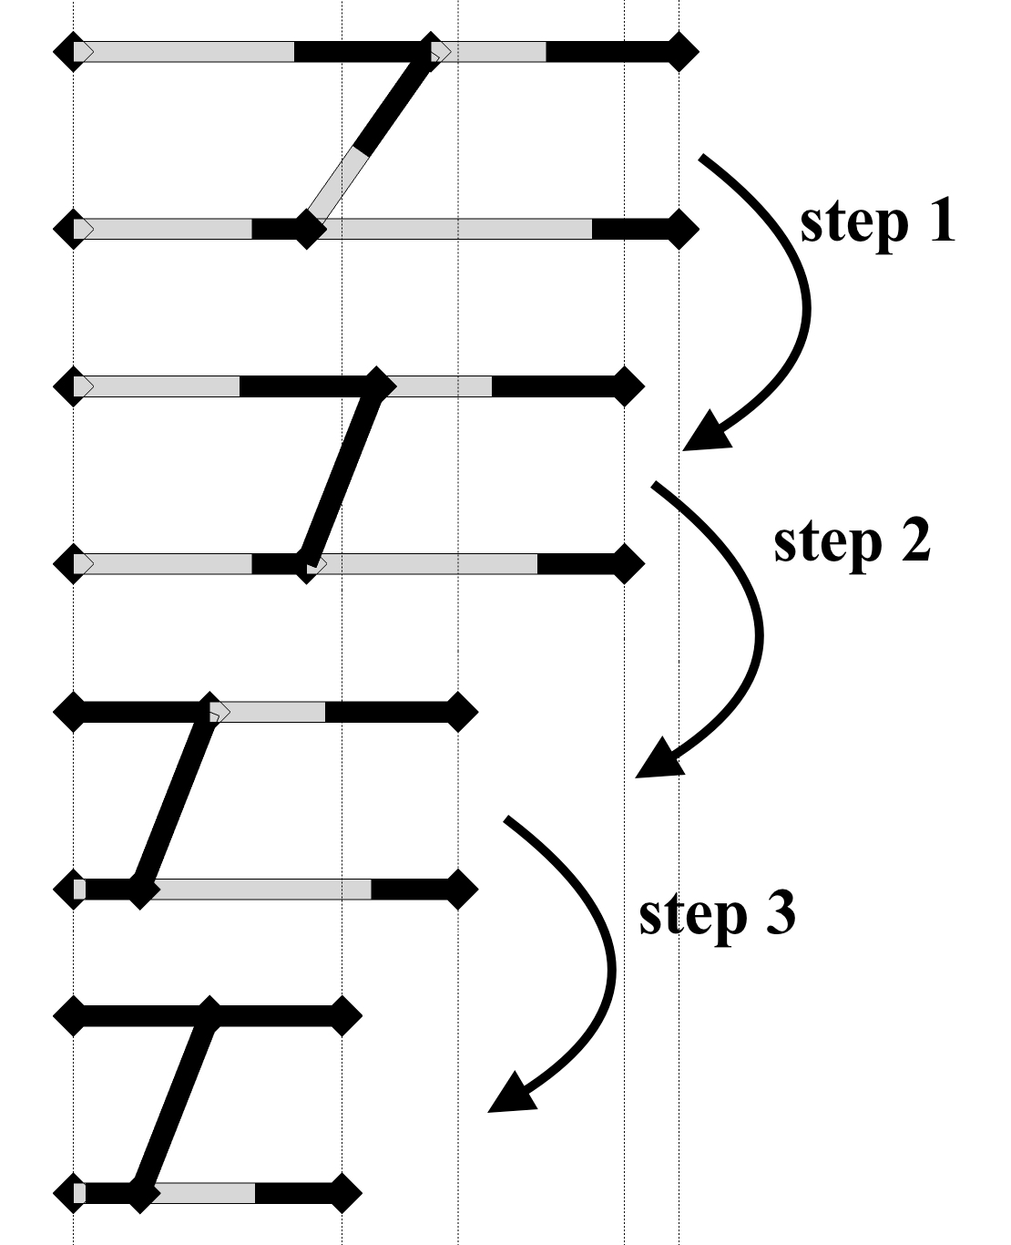
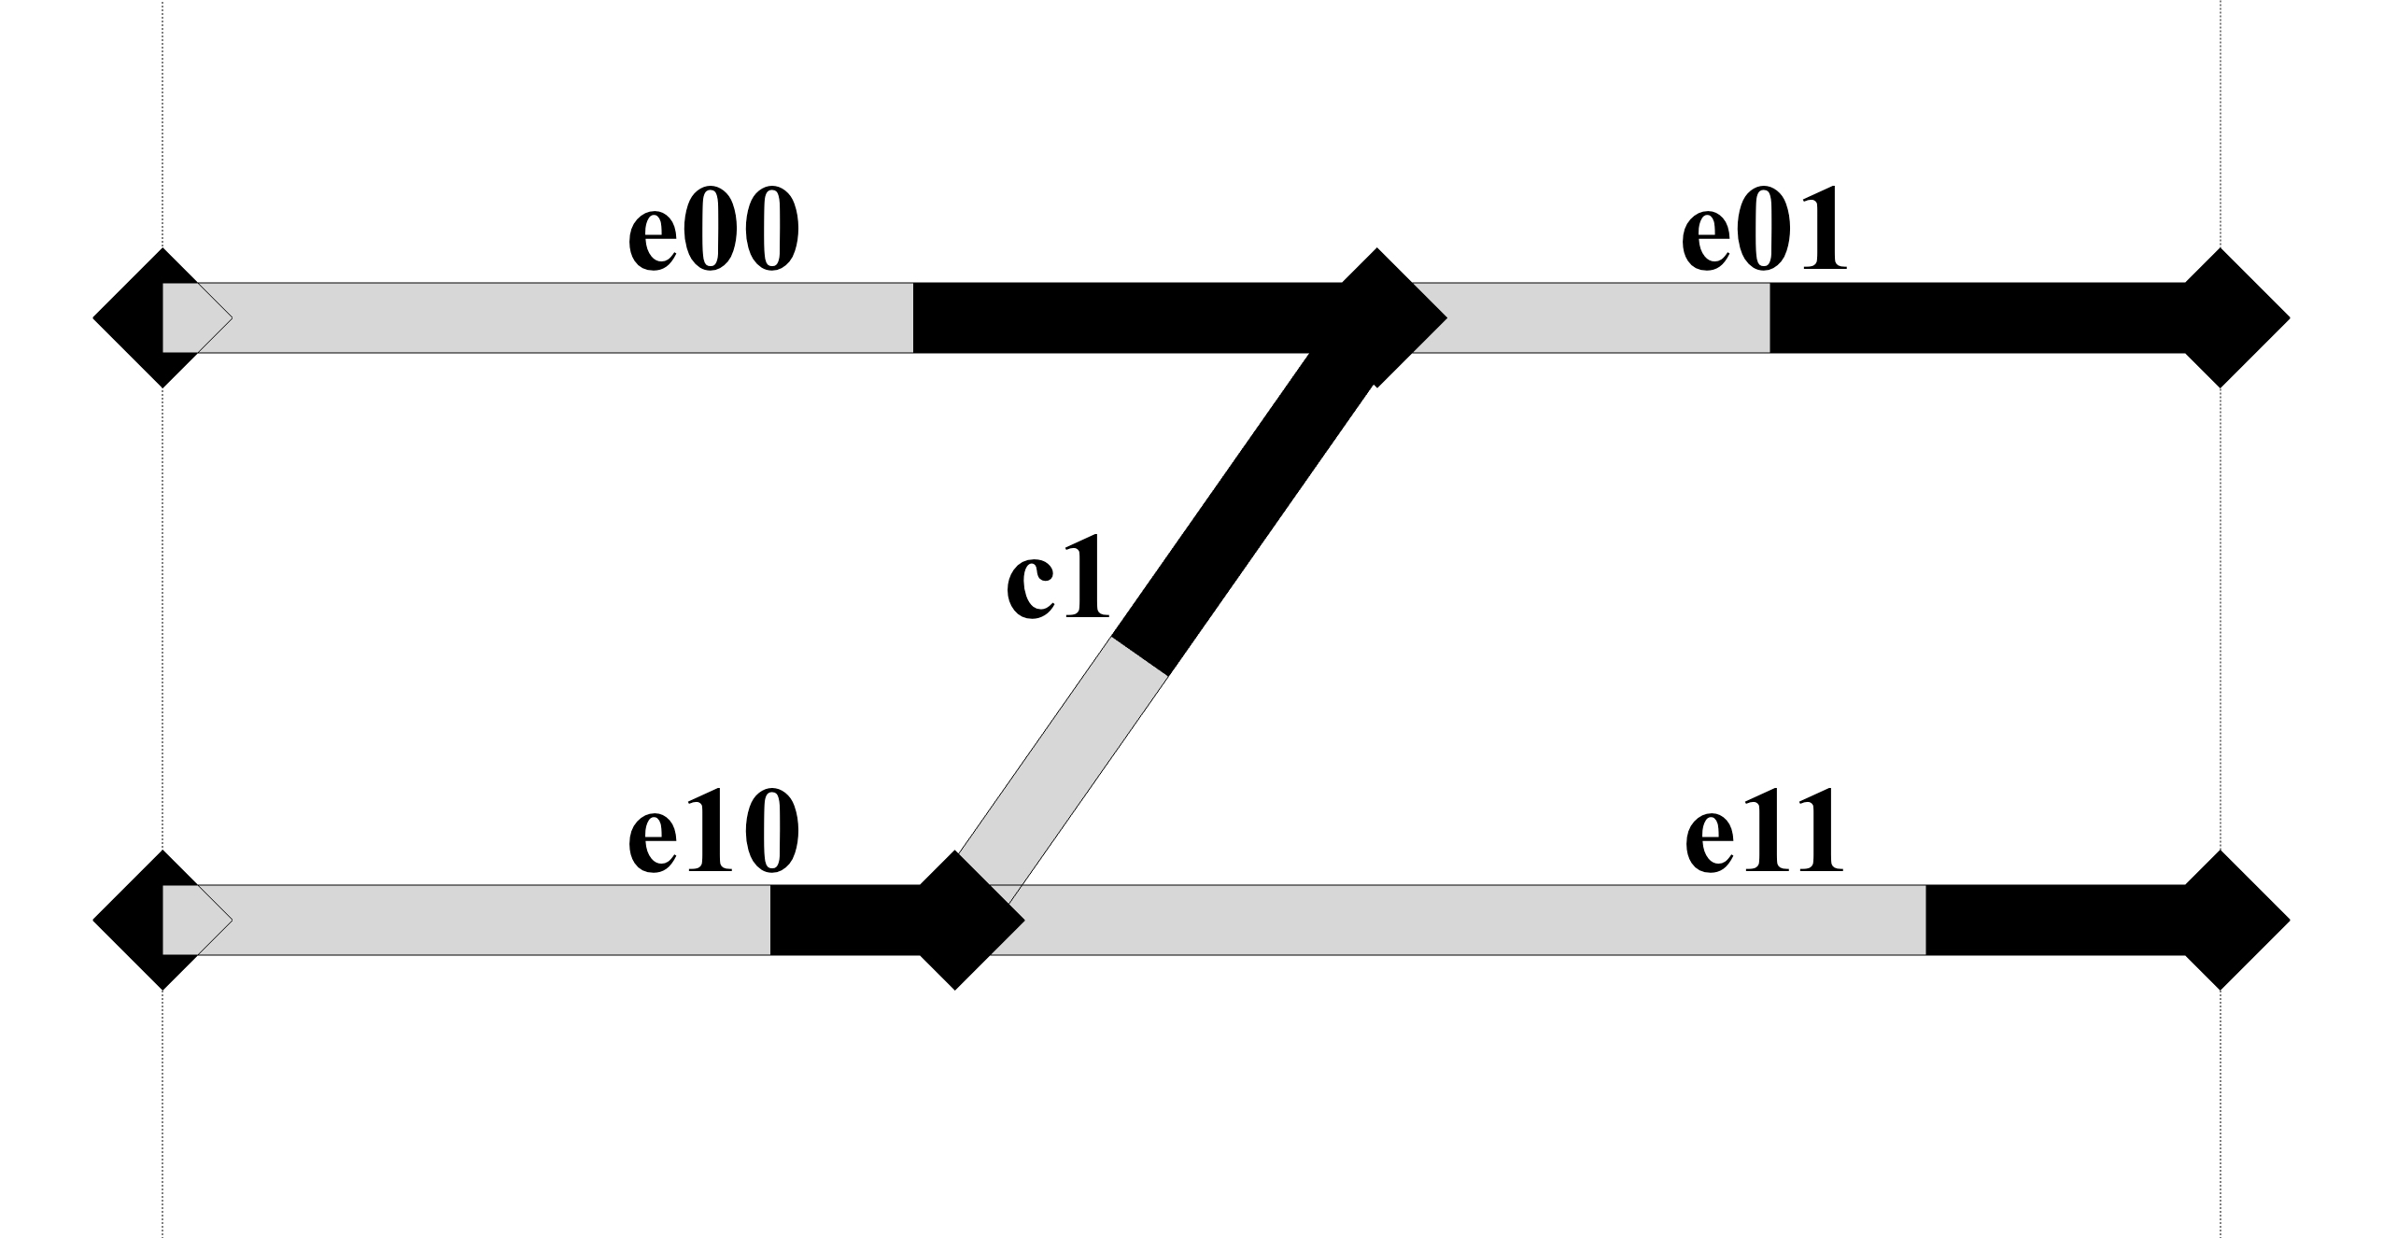
Description of a solution
Initial state
Deformation history

Slide 4
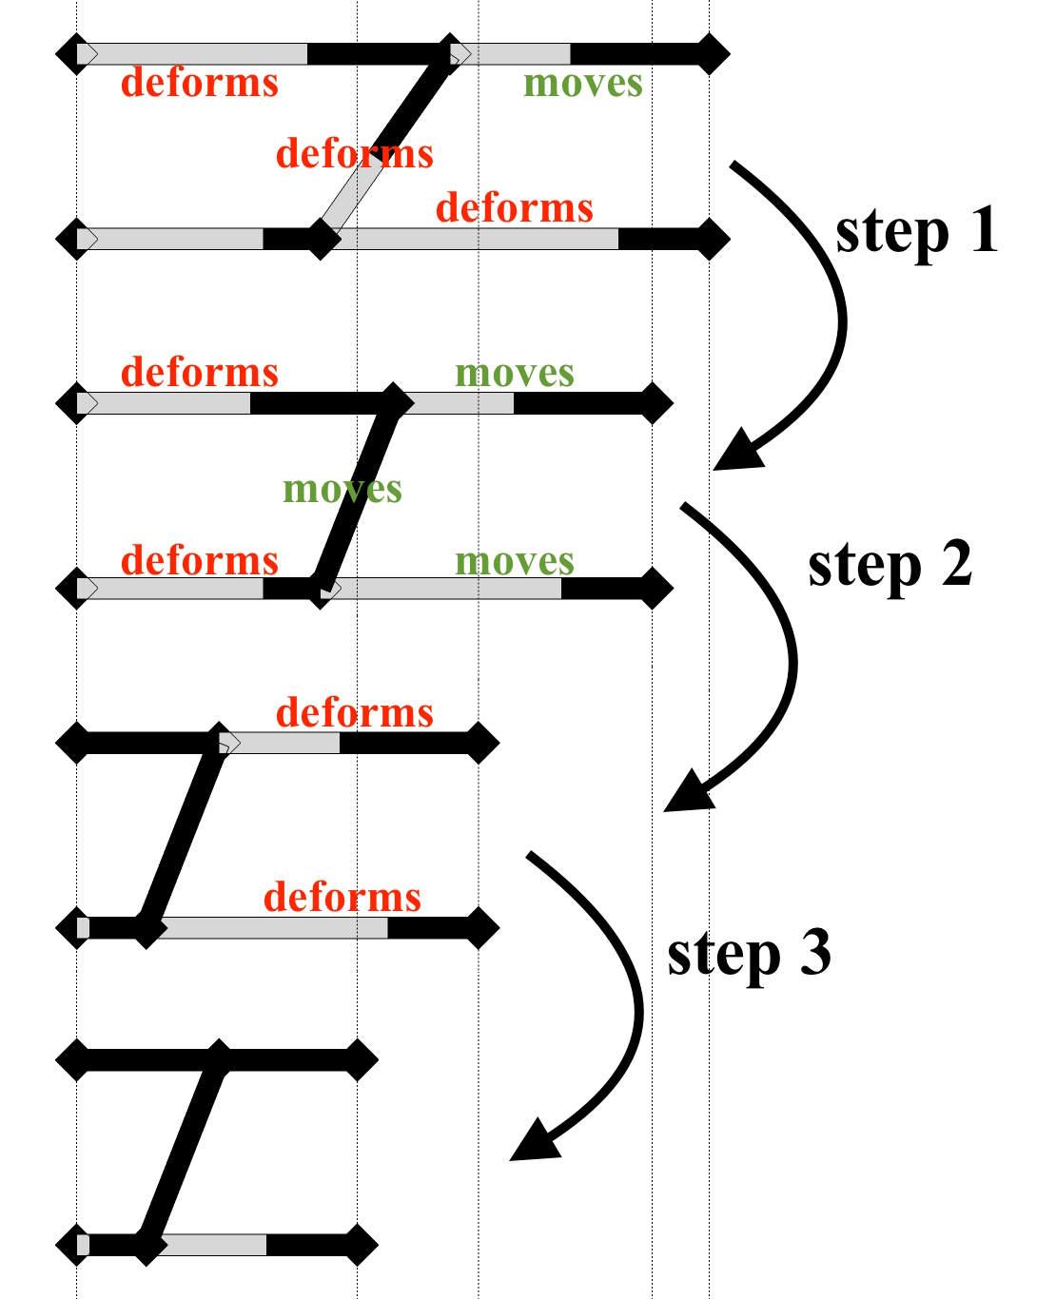
What is a deformation step?
Each deformation step contains:
amount of deformation
Information about active components and their transformation

Slide 5
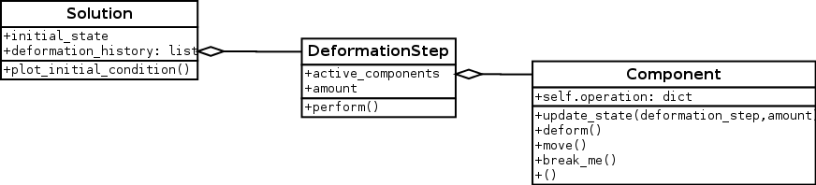
“Initial State – Deformation History” module

Slide 6
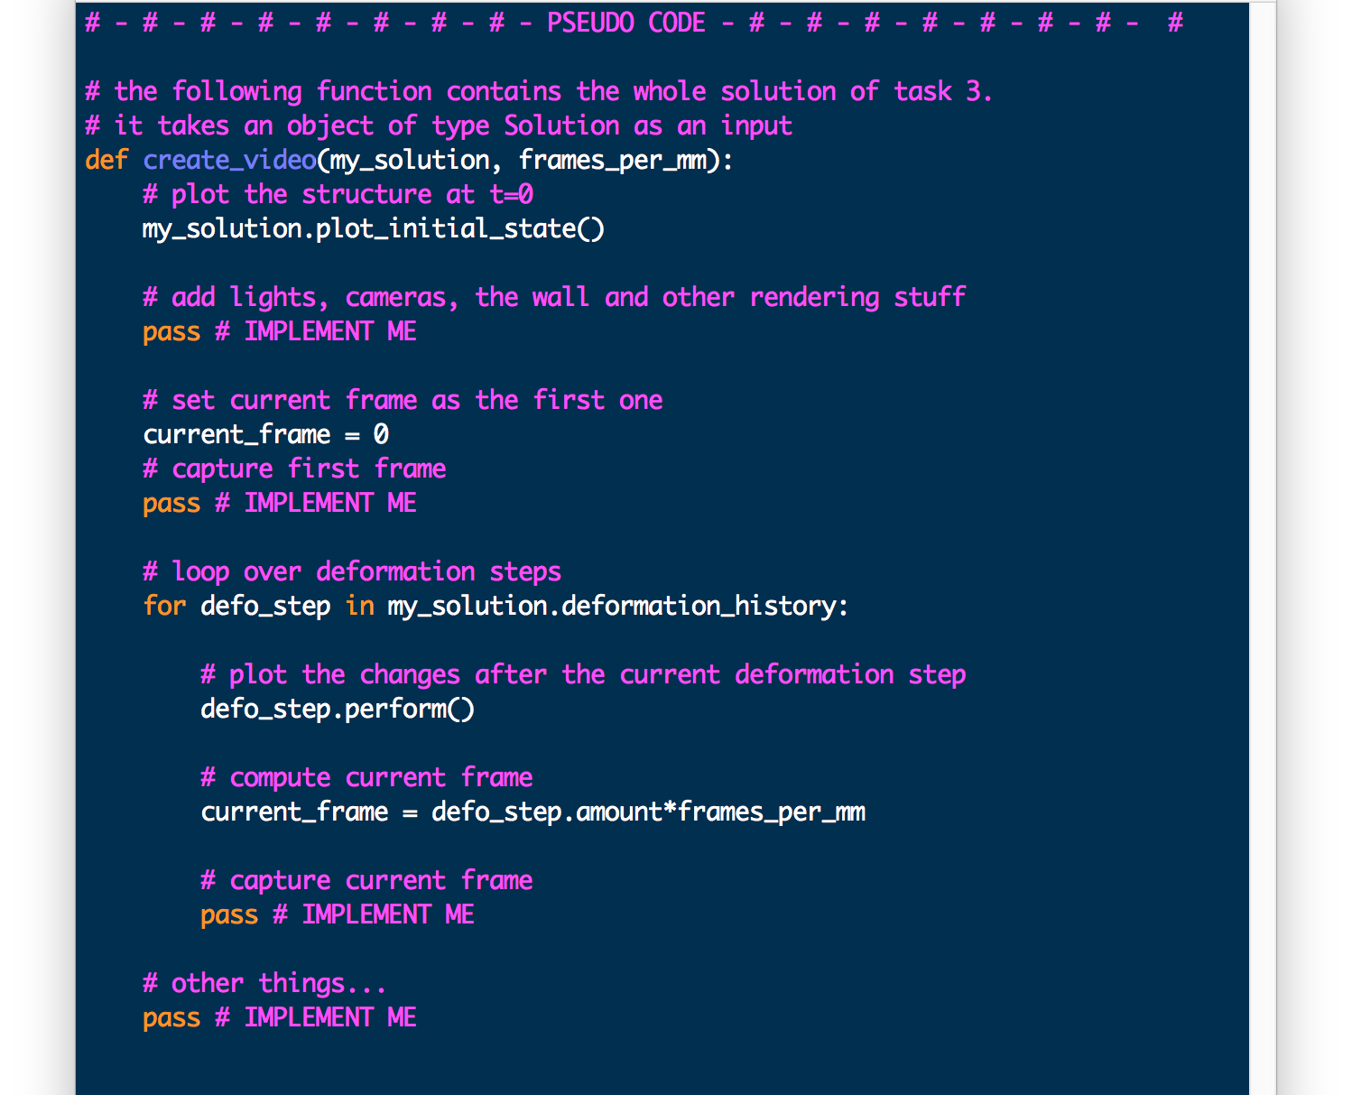
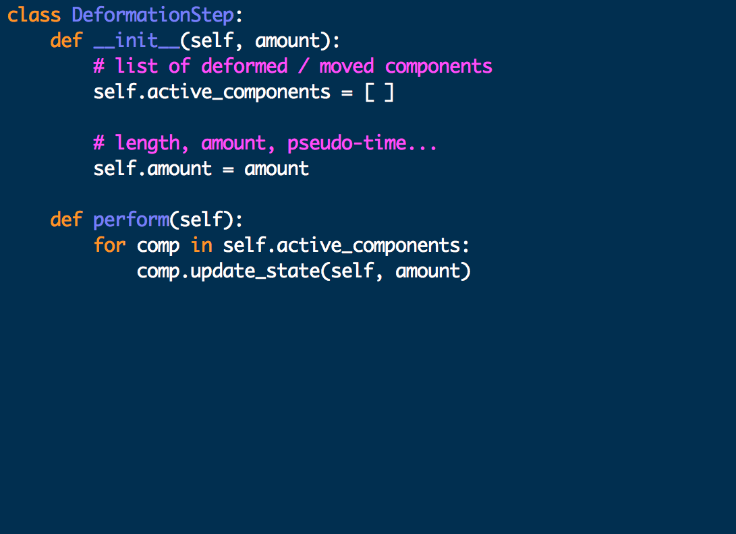
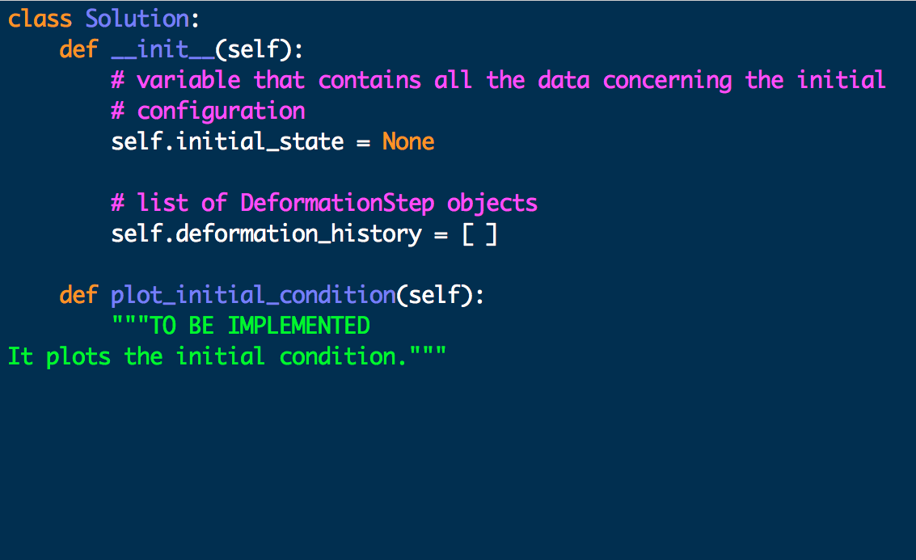
How to use the interface
A deformationStep object is defined this way:
my_solution is a Solution object with:
self.initial_state
self.deformation_history
deformation_history is a list of DeformationStep objects
initial_state contains all the information ragarding the structure.
This infromation is used by plot_initial_state(), which draws all the rectangles needed.

